Slide 1


Human Activity Recognition Using Deep Learning
Understanding how Deep Learning models recognize human activities using sensor data.
Presented To:
Dr. Kamlesh Dutta
Presented By: 21DCS024
Ashish Kumar

Slide 2
Introduction
What is Human Activity Recognition (HAR)?
HAR involves identifying human activities (e.g., walking, sitting, climbing stairs) using sensor data.
Used in healthcare, fitness tracking, smart surveillance, and human-computer interaction.

Slide 3
Why Human Activity Recognition?
Applications:
Healthcare monitoring (fall detection, elderly care)
Fitness and sports analytics
Smart home automation
Challenges:
Noise in sensor data
Variability in human movements
Real-time processing constraints

Slide 4
Deep Learning Models for HAR
Traditional Machine Learning Approaches:
SVM, Decision Trees, Random Forests (limited feature extraction)
Deep Learning Approaches:
Convolutional Neural Networks (CNNs) – Feature extraction
Recurrent Neural Networks (RNNs) – Sequence modeling
Long Short-Term Memory Networks (LSTMs) – Best for time-series classification

Slide 5
LSTM models handle sequential data efficiently.
They capture long-term dependencies in sensor readings.
Useful for recognizing complex patterns in movement.
Why LSTM for HAR?
LSTM models handle sequential data efficiently.
They capture long-term dependencies in sensor readings.
Useful for recognizing complex patterns in movement.

Slide 6
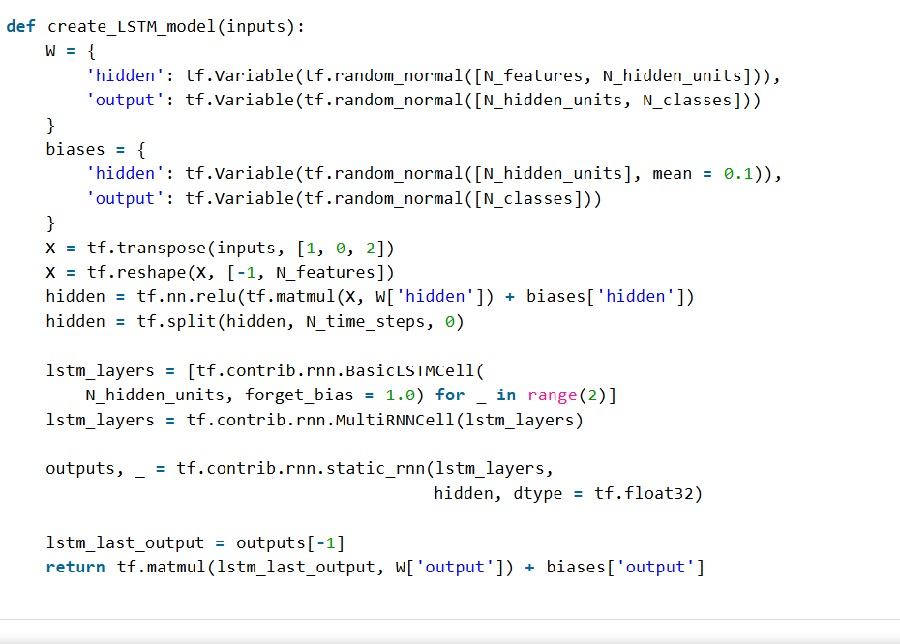
Input Layer: Preprocessed sensor data (accelerometer, gyroscope readings)
Hidden Layers: Multiple LSTM layers for sequential learning
Output Layer: Softmax activation for multi-class classification
LSTM Model Architecture
Input Layer:
Preprocessed sensor data (accelerometer, gyroscope readings)
Hidden Layers:
Multiple LSTM layers for sequential learning
Output Layer:
Softmax activation for multi-class classification

Slide 7
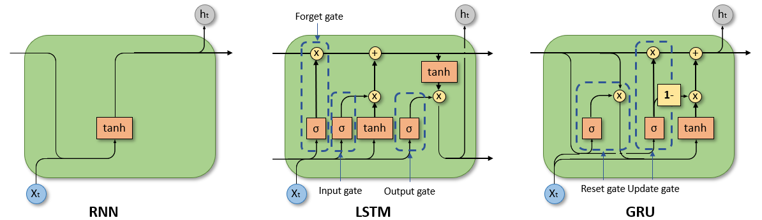
RNN AND LSTM ARCHITECTURE MODEL

Slide 8
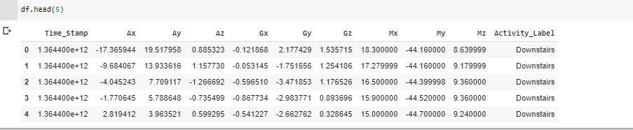
HAR Dataset
Dataset Used:
Public HAR dataset with accelerometer & gyroscope data.
Activities Classified:
Walking, Sitting, Standing, Upstairs, Downstairs.
Data Characteristics:
Collected in a 3D space (X, Y, Z axes)
Train/Test Split: 80% training, 20% testing.

Slide 9
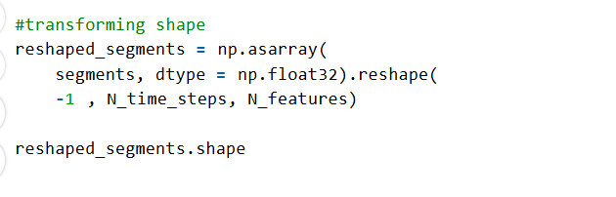
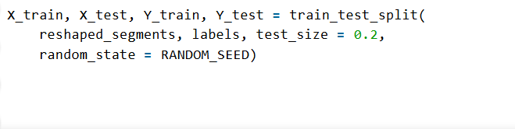
Data Preprocessing
Steps in Preprocessing:
Filtering noise from sensor data.
Normalization of values.
Splitting data into training & testing sets.
Feature Engineering:
Extracting meaningful features from raw signals.

Slide 10
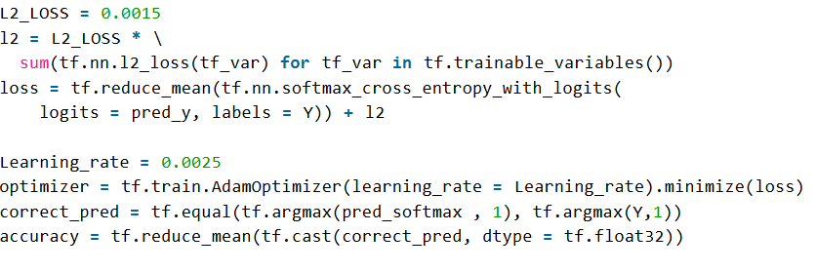
Model Training & Optimization
Hyperparameters:
Learning rate: 0.0025
Batch size: 1024
Epochs: 50
Optimization Algorithm :
Adam Optimizer to minimize loss.

Slide 11
Evaluation metrics
Accuracy:
The percentage of correct predictions out of the total predictions made.
2. Precision, Recall, and F1-Score:
Precision:
The percentage of correctly predicted positive cases out of all predicted positive cases.
Recall (Sensitivity):
The percentage of correctly predicted positive cases out of all actual positive cases.
F1-Score:
The harmonic mean of precision and recall, balancing both metrics.
3. MAE (Mean Absolute Error) and RMSE (Root Mean Squared Error):
MAE:
The average absolute difference between predicted and actual values.

Slide 12
Evaluation metrics
RMSE:
The square root of the average squared differences between predicted and actual values.
4. AUC-ROC (Area Under the Receiver Operating Characteristic Curve):
ROC Curve: Plots the True Positive Rate (Recall) against the False Positive Rate (1 - Specificity).
AUC: The area under the ROC curve, ranging from 0 to 1.
5. Cohen’s Kappa
Measures the agreement between predicted and actual classes, accounting for random chance.
6. Validation: Cross-Validation and External Datasets
Cross-Validation:
A technique to assess model performance by splitting the dataset into multiple subsets (folds), training on some folds, and validating on the remaining fold.

Slide 13
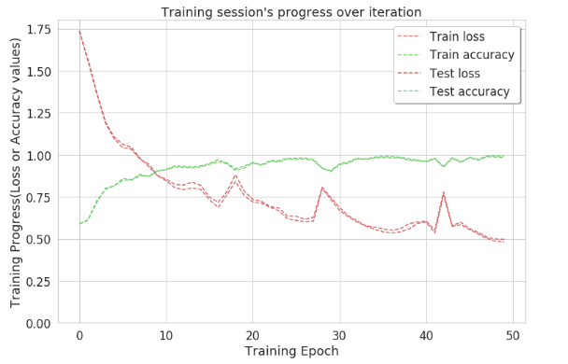
Model Performance
Accuracy Trends: Model reaches ~99% accuracy at the 50th iteration
.
Loss Reduction: Loss decreases consistently with training.

Slide 14
Drawbacks of current models
Challenges in HAR:
Requires large labeled datasets.
High computational cost.
Difficult real-time deployment.

Slide 15
Future Scope
Possible Improvements :
Optimizing for real-time processing using Edge AI.
Exploring Transformer models for better sequence modelling .
Multimodal Learning: Combining sensor + video data.

Slide 16
Conclusion
LSTM-based HAR models achieve high accuracy.
Deep Learning effectively handles sequential sensor data.
Future work focuses on real-time deployment & multimodal analysis.

Slide 17
THANK YOU
Questions?

